Slide 1
Build on the Rock

Slide 2
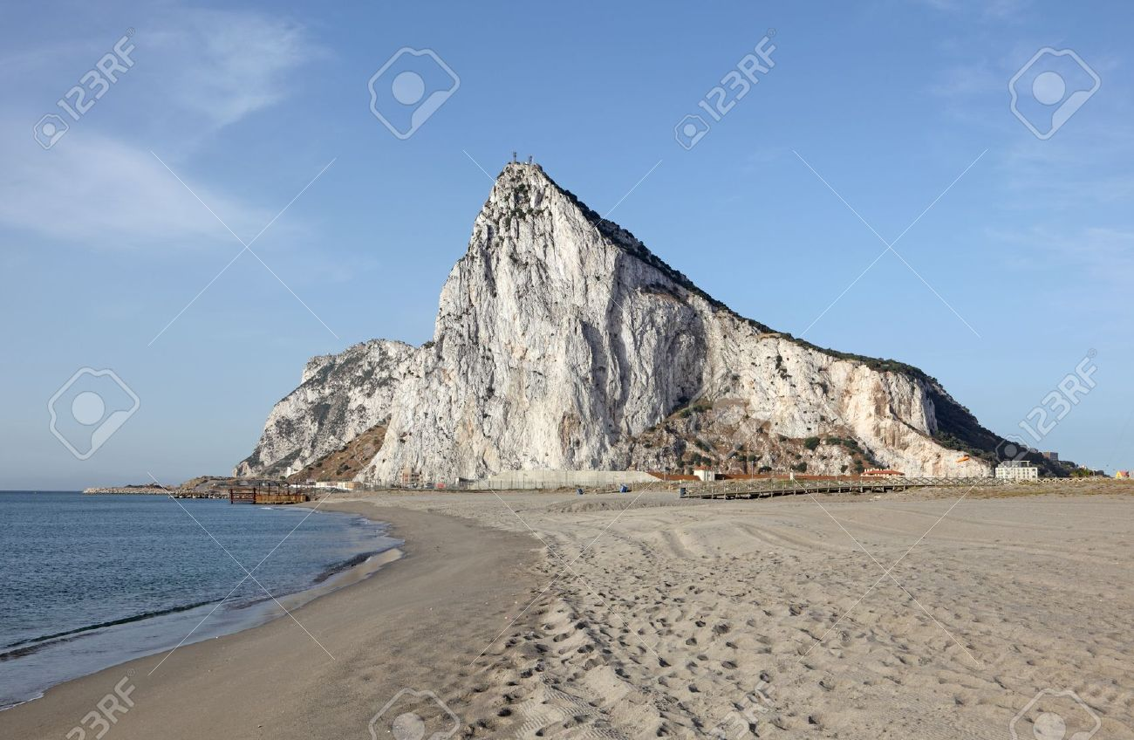

Slide 3
⁴⁶ “So why do you keep calling me ‘Lord, Lord!’ when you don’t do what I say? ⁴⁷ I will show you what it’s like when someone comes to me, listens to my teaching, and then follows it. ⁴⁸ It is like a person building a house who digs deep and lays the foundation on solid rock. When the floodwaters rise and break against that house, it stands firm because it is well built. ⁴⁹ But anyone who hears and doesn’t obey is like a person who builds a house right on the ground, without a foundation. When the floods sweep down against that house, it will collapse into a heap of ruins.” Luke 6:46-49

Slide 4
¹⁰ Because of God’s grace to me, I have laid the foundation like an expert builder. Now others are building on it. But whoever is building on this foundation must be very careful. ¹¹ For no one can lay any foundation other than the one we already have—Jesus Christ.¹² Anyone who builds on that foundation may use a variety of materials—gold, silver, jewels, wood, hay, or straw. ¹³ But on the judgment day, fire will reveal what kind of work each builder has done. The fire will show if a person’s work has any value. 1 Corinthians 3:10-13

Slide 5
The building blocks of a firm foundation!
Surrender
Commitment
Humility
Endurance
A strong Finish

Slide 6
Surrender: to give oneself up, as into the power of another; submit or yield.
"If you would direct your heart right And spread out your hand to Him, Job 11:13

Slide 7
And do not go on presenting the members of your body to sin as instruments of unrighteousness; but present yourselves to God as those alive from the dead, and your members as instruments of righteousness to God. Romans 6:13
But now, O LORD, You are our Father, We are the clay, and You our potter; And all of us are the work of Your hand Isaiah 64:8

Slide 8
Commitment: the act of committing, pledging, or engaging oneself
Commit your way to the Lord; trust in him, and he will act. Psalm 37:5
Commit your work to the LORD, and your plans will be established. Proverbs 16:3

Slide 9
"He who loves father or mother more than Me is not worthy of Me; and he who loves son or daughter more than Me is not worthy of Me. "And he who does not take his cross and follow after Me is not worthy of Me. Matthew 10:37-38

Slide 10
Humility:
At it’s core this is the reason there is a separation between us and God. When pride enters and we give way to it’s demands we elevate ourselves and cause the separation. This is the reason humility is so pivotal. It literally opens the door to surrender to the Savior.

Slide 11
Humility: not proud or arrogant; modest
Do nothing out of selfish ambition or vain conceit. Rather, in humility value others above yourselves Philippians 2:3
When pride comes, then comes disgrace, but with humility comes wisdom. Proverbs 11:2
Humility is the fear of the Lord; its wages are riches and honor and life. Proverbs 22:4

Slide 12
Endurance: the ability or strength to continue or last, especially despite fatigue, stress, or other adverse conditions; stamina
"A bruised reed He will not break And a dimly burning wick He will not extinguish; He will faithfully bring forth justice. "He will not be disheartened or crushed Until He has established justice in the earth; And the coastlands will wait expectantly for His law." Isaiah 42:3-4

Slide 13
But in everything commending ourselves as servants of God, in much endurance, in afflictions, in hardships, in distresses, in beatings, in imprisonments, in tumults, in labors, in sleeplessness, in hunger, in purity, in knowledge, in patience, in kindness, in the Holy Spirit, in genuine love, read more. in the word of truth, in the power of God; by the weapons of righteousness for the right hand and the left, by glory and dishonor, by evil report and good report; regarded as deceivers and yet true; as unknown yet well-known, as dying yet behold, we live; as punished yet not put to death, as sorrowful yet always rejoicing, as poor yet making many rich, as having nothing yet possessing all things 2 Corinthians 6:4-10

Slide 14
² “I know all the things you do. I have seen your hard work and your patient endurance. I know you don’t tolerate evil people. You have examined the claims of those who say they are apostles but are not. You have discovered they are liars. ³ You have patiently suffered for me without quitting. Revelation 2:3
Blessed is a man who perseveres under trial; for once he has been approved, he will receive the crown of life which the Lord has promised to those who love Him. James 1:12

Slide 15
Finish Strong:
I have fought the good fight, I have finished the race, I have kept the faith. 2 Timothy 4:7
But I do not account my life of any value nor as precious to myself, if only I may finish my course and the ministry that I received from the Lord Jesus, to testify to the gospel of the grace of God. Acts 20:24

Slide 16
Therefore, since we are surrounded by so great a cloud of witnesses, let us also lay aside every weight, and sin which clings so closely, and let us run with endurance the race that is set before us Hebrews 12:1
For which of you, desiring to build a tower, does not first sit down and count the cost, whether he has enough to complete it? Otherwise, when he has laid a foundation and is not able to finish, all who see it begin to mock him, saying, ‘This man began to build and was not able to finish.’ Luke 14:28-30

Slide 17
Do you not know that in a race all the runners run, but only one receives the prize? So run that you may obtain it. Every athlete exercises self-control in all things. They do it to receive a perishable wreath, but we an imperishable. So I do not run aimlessly; I do not box as one beating the air. But I discipline my body and keep it under control, lest after preaching to others I myself should be disqualified. 1 Corinthians 9:24-27
I press on toward the goal for the prize of the upward call of God in Christ Jesus. Philippians 3:14

Slide 18
So as to walk in a manner worthy of the Lord, fully pleasing to him, bearing fruit in every good work and increasing in the knowledge of God. May you be strengthened with all power, according to his glorious might, for all endurance and patience with joy, giving thanks to the Father, who has qualified you to share in the inheritance of the saints in light. He has delivered us from the domain of darkness and transferred us to the kingdom of his beloved Son, in whom we have redemption, the forgiveness of sins.
C Colossians 1:10-14

